Slide 1
Performance behavior of microservice-based cloud applications
Mauro Famà

Slide 2
What are microservices?

Slide 3
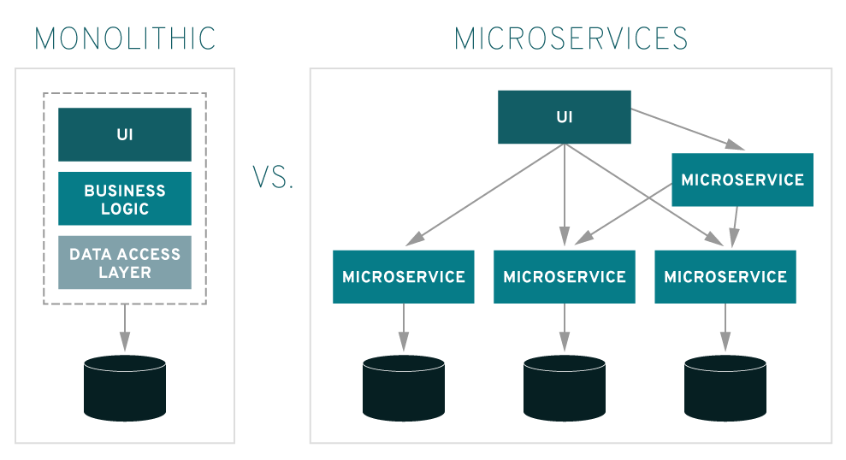
What are microservices?
https://www.redhat.com/it/topics/microservices/what-are-microservices

Slide 4
Containerized Applications

Slide 5

Containerized Applications
Virtual Machines based applications:
Infrastructure
Host operating system
Hypervisor
Guest OS
Applications

Slide 6


Containerized Applications
Virtual Machines based applications:
Infrastructure
Host operating system
Hypervisor
Guest OS
Applications
Container based applications:
Infrastructure
Host operating system
Docker/containerd
Applications

Slide 7

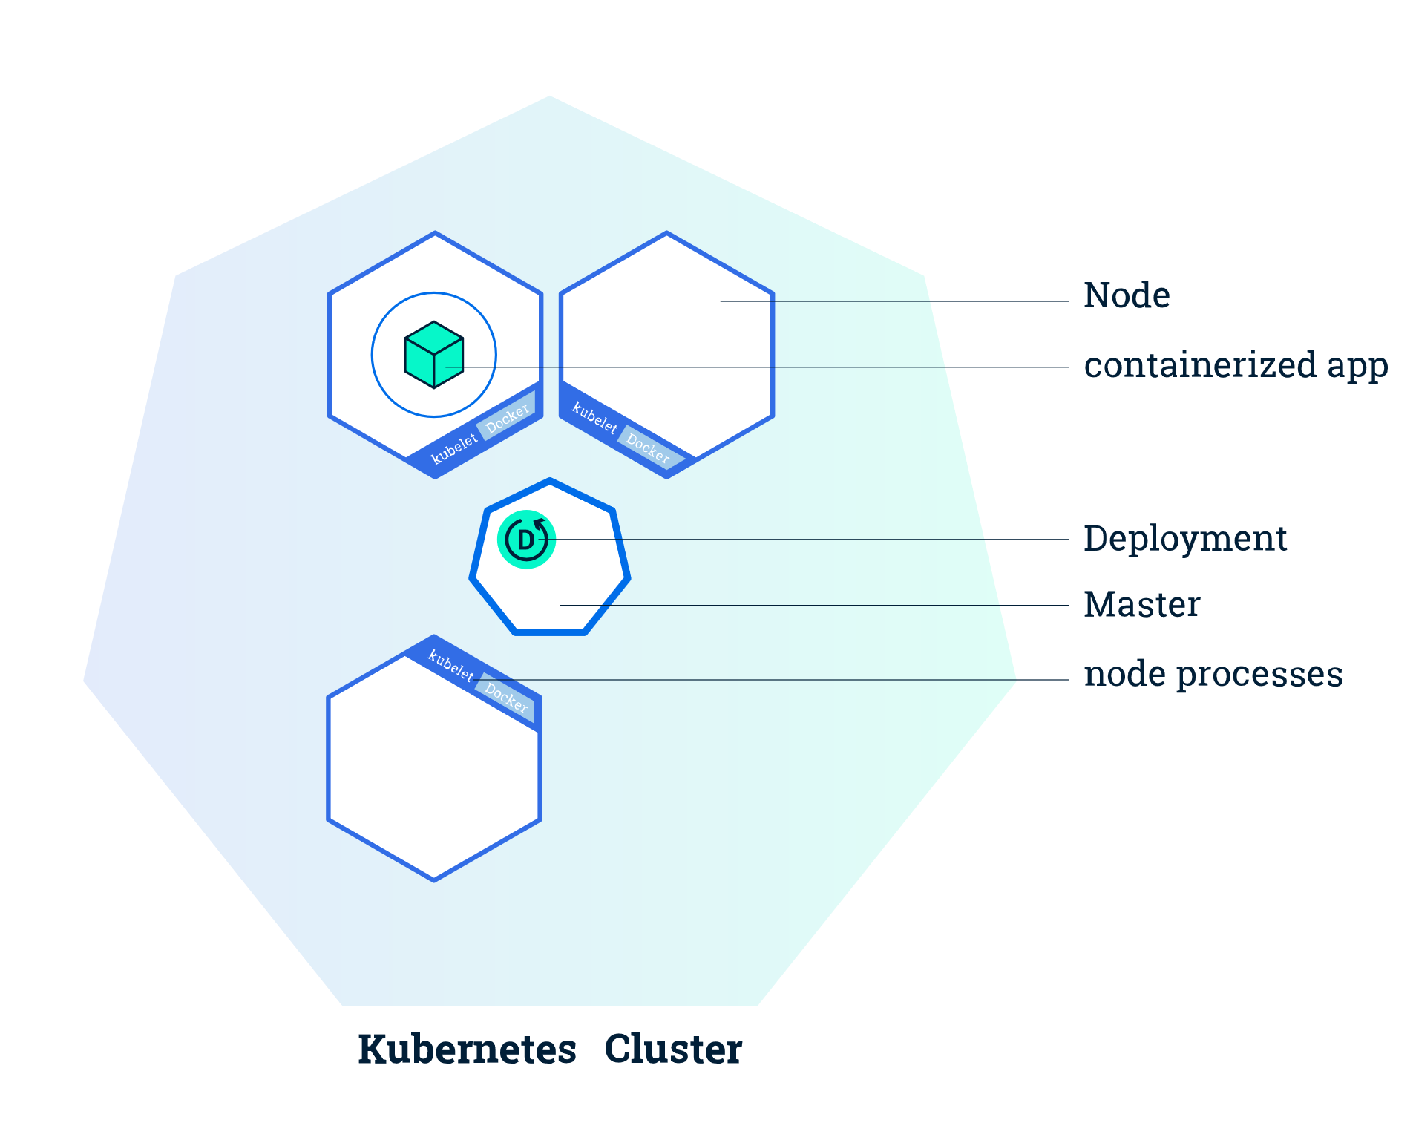
Extendible platform for managing containerized workloads and services
https://kubernetes.io

Slide 8

Extendible platform for managing containerized workloads and services
Physical Machine
https://kubernetes.io

Slide 9

Extendible platform for managing containerized workloads and services
Physical Machine
Cloud Platform
https://kubernetes.io

Slide 10

DeathStarBench
Social Network
Media Services
Hotel Reservation

Slide 11

DeathStarBench
Social Network
Media Services
Hotel Reservation
WRK2
HTTP benchmarking tool capable of generating working loads

Slide 12
Physical Hardware Implementation

Slide 13
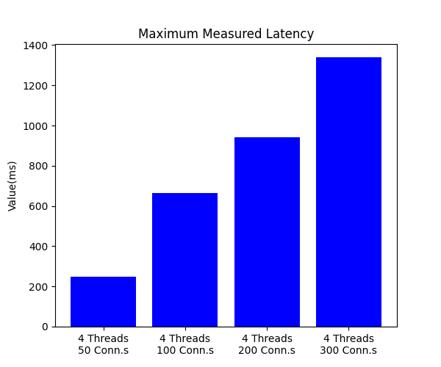
Physical Hardware Implementation
Latency Distribution
Generating workloads with the same number of threads, but with increasing connections, shows that latency proportionally increases with the number of opened connections.

Slide 14
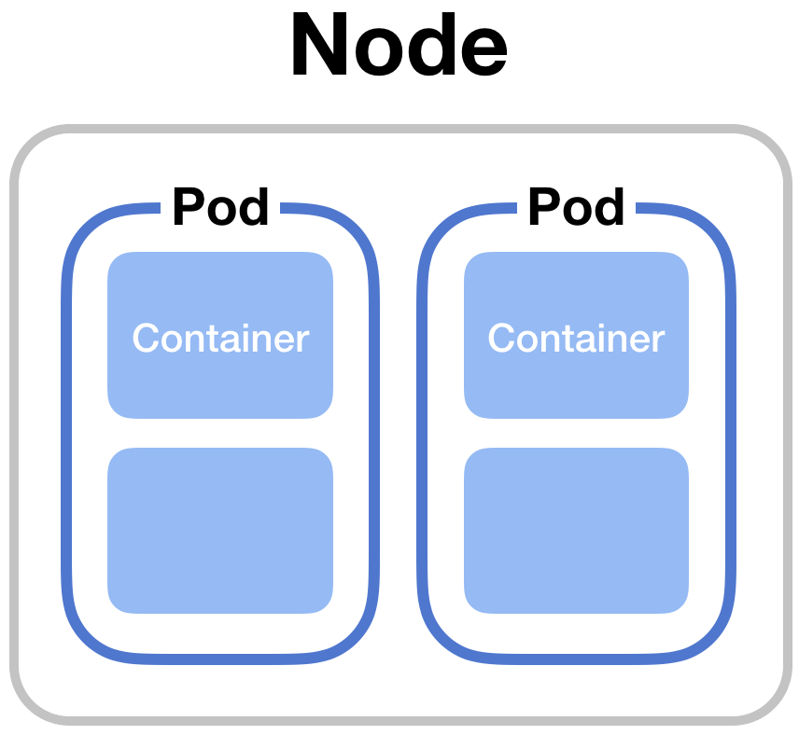
Physical Hardware Implementation
Horizontal Pod Scaling

Slide 15
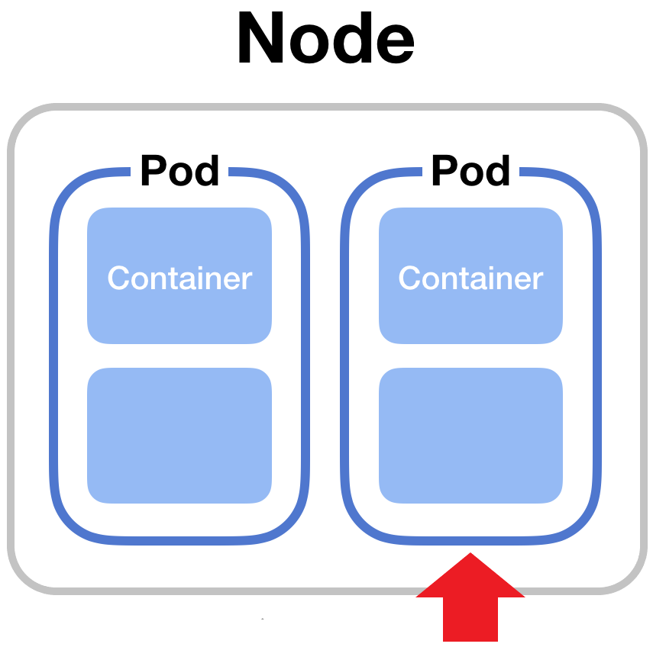
Physical Hardware Implementation
Horizontal Pod Scaling

Slide 16
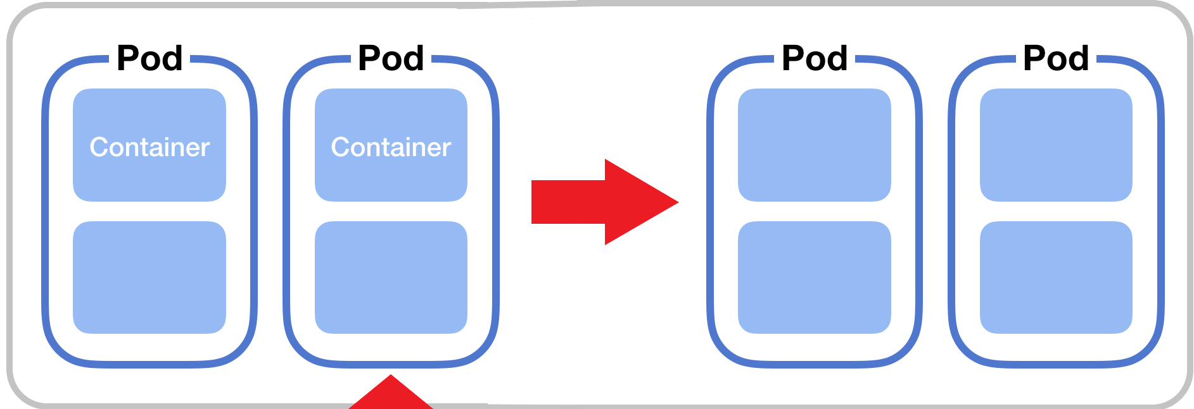
Physical Hardware Implementation
Horizontal Pod Scaling

Slide 17
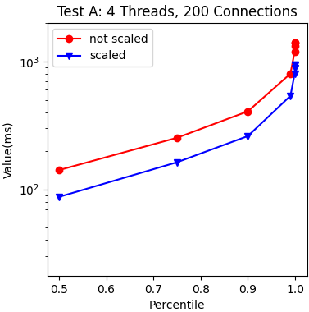
Physical Hardware Implementation
Horizontal Pod Scaling
By increasing the number of replicas of a pod which is the bottleneck and becomes very stressed after a certain workload, performances can be improved, and latency distribution can be way better

Slide 18
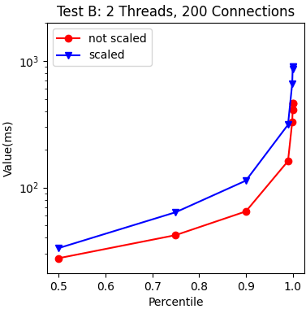
Physical Hardware Implementation
Horizontal Pod Scaling
But if you increase the number of replicas of a pod which is not the bottleneck of the network and it is not stressed, performances can deteriorate because pods are not working correctly

Slide 19

Cloud Infrastructure Implementation
Reliability
Deploying the benchmark with a powerful cloud solution such AWS implies that waiting time due to poor connection is not a problem anymore.
Security
Now SSH keys are necessary to manage the nodes of the cluster.

Slide 20
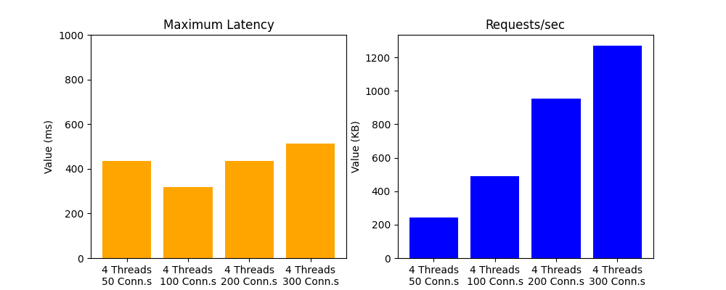
Cloud Infrastructure Implementation
Maximum Latency measured
Maximum measured latency remains about the same (it could even decrease) even with an increasing number of connections, although the nodes can still manage all the open connections very well, guaranteeing performance and speed in the computational phase.

Slide 21
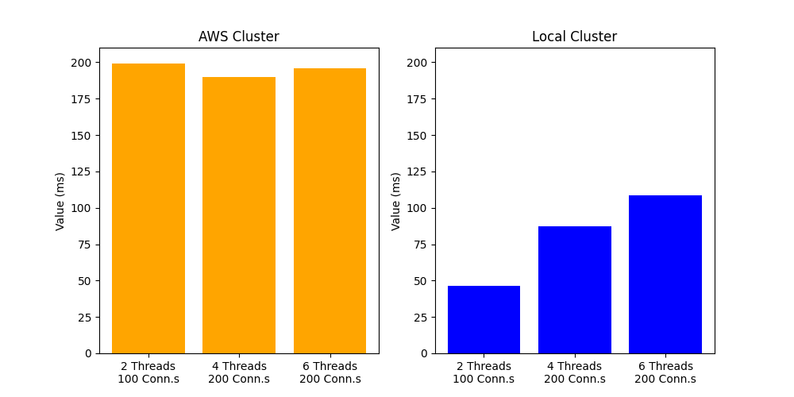
Cloud Infrastructure Implementation
50th percentile Latency
Latency measured when the requests flow is still at the beginning is significatively high, much more than the measurements taken on the cluster deployed on the physical machine, although the connectivity is worse.

Slide 22
STRENGTHS

Slide 23

STRENGTHS
Superior Scaling

Slide 24

STRENGTHS
Superior Scaling
Accessibility

Slide 25

STRENGTHS
Superior Scaling
Accessibility
Resilience

Slide 26
WEAKNESSES

Slide 27

WEAKNESSES
Management

Slide 28

WEAKNESSES
Management
Versioning

Slide 29

WEAKNESSES
Management
Versioning
Connectivity

Slide 30
Thank you!
Mauro Famà

